Slide 1
Elastic Tunneling 정리 진명

Slide 2
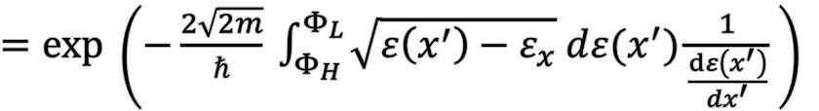




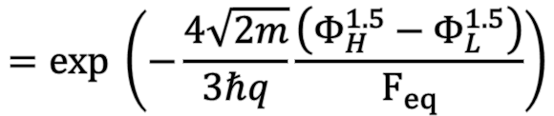

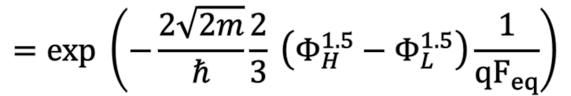
Tunneling Coefficient
The WKB Approximation
…
$TC=exp \left(−\frac{2}{ℏ} \int_{x_{1}}^{x_{2}}{\sqrt{2m \left(W\left(x^{′}\right)−ε\right)} dx′}\right)$
$\vec{F_{eq}}$
$TC=exp \left(−\frac{2\sqrt{2m}}{ℏ} \int_{0}^{x_{L}}{\sqrt{ε\left(x^{′}\right)−ε_{x}} dx^{′}}\right)$
$${qΦ}_{H}$$
$${qΦ}_{L}$$
$=exp \left(−\frac{2\sqrt{2m}}{ℏ} \int_{Φ_{H}}^{Φ_{L}}{\sqrt{ε\left(x^{′}\right)−ε_{x}} d{ε(x}^{′})\frac{1}{\frac{dε\left(x^{′}\right)}{dx^{′}}}} \right)$
$Uniform Field Assumption :\vec{F_{eq}}$
$$=exp \left(−\frac{2\sqrt{2m}}{ℏ}\frac{2}{3} \left(Φ_{H}^{1.5}−Φ_{L}^{1.5}\right)\frac{1}{{qF}_{eq}}\right)$$
$$=exp \left(−\frac{4\sqrt{2m}}{3ℏq}\frac{\left(Φ_{H}^{1.5}−Φ_{L}^{1.5}\right)}{F_{eq}}\right)$$

Slide 3
Elastic Tunneling of Electron
Main Assumption
Energy level of electron conserves in tunneling procedure
Fermi level depends on the operation of the device
At FN tunneling state, Fermi level is above the conduction band level
At retention state, Fermi level is about trap level
FN tunneling state in high current
Direct tunneling state in Retention
Excessive electron current
~ Step function
$$E_{Fn}$$
Electron gas in Conduction band
~ Boltzmann Distribution
$$E_{Fn}$$
Trapped electrons

Slide 4
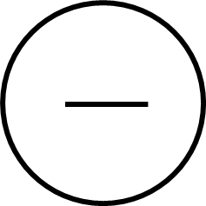

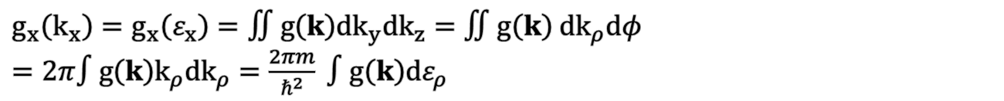


Tunneling Current Modeling
Conventional Current Density: $J=q v n$
Occupied electron state : f₁(ε)
Available electron state : 1 - f₂(ε)
$$J=q v n ⇒$$
TC
$∴ J=qvn×TC$
Area
$\left(dn_{x}=g_{x}\left(k_{x}\right) {dk}_{x}\right)$
${dJ}_{1→2}=q TC f_{1}\left(ε\right)\left(1−f_{2}\left(ε\right)\right) v_{x} {dn}_{x}= q TC\left(k_{x}\right) v_{x} g_{x}\left(k_{x}\right)f_{1}\left(ε\right)\left(1−f_{2}\left(ε\right)\right){dk}_{x}$
By quantum relation, $v_{x} {dk}_{x}=\frac{1}{ℏ} dε_{x} , k_{x} {dk}_{x}=\frac{m}{ℏ^{2}} dε_{x}, g_{x}\left(k_{x}\right)=∬g\left(k\right){dk}_{y}{dk}_{z}$
$g_{x}\left(k_{x}\right)=g_{x}\left(ε_{x}\right)=∬g\left(k\right){dk}_{y}{dk}_{z}=∬g\left(k\right) {dk}_{ρ}dφ$
$=2π∫g\left(k\right)k_{ρ}{dk}_{ρ}=\frac{2πm}{ℏ^{2}} ∫g\left(k\right)dε_{ρ}$

Slide 5
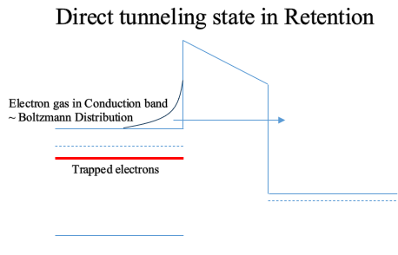

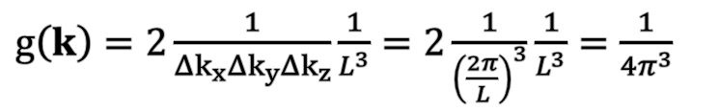


Direct Tunneling
${dJ}_{1→2}=q TC\left(ε_{x}\right)v_{x}{dn}_{x}=qTC\left(ε_{x}\right)v_{x}g_{x}\left(k_{x}\right)f_{1}\left(ε\right)\left(1−f_{2}\left(ε\right)\right){dk}_{x}$
$g\left(k\right)=2\frac{1}{Δk_{x}Δk_{y}Δk_{z}}\frac{1}{L^{3}}=2\frac{1}{{\left(\frac{2π}{L}\right)}^{3}}\frac{1}{L^{3}}=\frac{1}{{4π}^{3}}$
DoS of periodic space
$⇒ g_{x}\left(k_{x}\right)=\frac{2πm}{ℏ^{2}} ∫g\left(k\right)dε_{ρ}$
$J=q\frac{4πm}{h^{3}} ∫TC\left(ε_{x}\right)N\left(ε_{x}\right) dε_{x}$ : Duke’s Tunneling Current Model
$$TC(ε):Tunneling Coefficient , N\left(ε\right):Supply Function$$
Quasi-Fermi level
$\left(E_{Fn}=E_{C} −kT ln \left(\frac{n_{C}}{N_{C}}\right)\right)$
$N\left(ε_{x}\right)=\int_{0}^{∞}{f_{1} \left(ε\right) \left(1−f_{2}\left(ε\right)\right) dε_{ρ}}=\int_{0}^{∞}{exp\left(−\frac{ε_{x}+ε_{ρ}−E_{Fn}}{kT}\right) dε_{ρ}}=kT exp\left(−\frac{ε_{x}−E_{Fn}}{kT}\right)$
$$e_{DT}=\frac{J}{q}×\left(Area\right) \int_{E_{c}}^{∞}{TC\left(ε_{x}\right) kT exp(− \frac{ε_{x}−E_{Fn}}{kT}) dε_{x}}$$

Slide 6

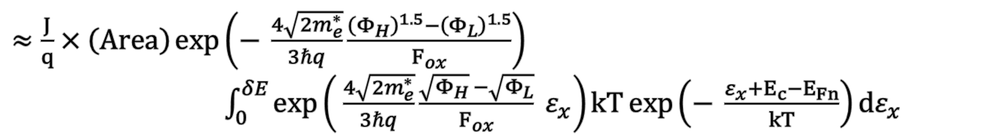


Direct Tunneling
$e_{DT}=\frac{J}{q}×\left(Area\right) \int_{E_{c}}^{∞}{TC\left(ε_{x}\right) kT exp(− \frac{ε_{x}−E_{Fn}}{kT}) dε_{x}}$
$≈ \frac{J}{q}×\left(Area\right) \int_{0}^{δE}{TC\left(ε_{x}\right) kT\exp\left(− \frac{ε_{x}+E_{c}−E_{Fn}}{kT}\right)dε_{x}} \left(δE≪E_{c}−ε_{x}\right)$
$≈\frac{J}{q}×\left(Area\right)\int_{0}^{δE}{\exp\left(− \frac{4\sqrt{2m_{e}^{∗}}}{3ℏq}\frac{{\left(Φ_{H}−ε_{x}\right)}^{1.5}−{\left(Φ_{L}−ε_{x}\right)}^{1.5}}{F_{ox}}\right) kT\exp\left(− \frac{ε_{x}+E_{c}−E_{Fn}}{kT}\right)dε_{x}}$
$≈\frac{J}{q}×\left(Area\right)\exp\left(− \frac{4\sqrt{2m_{e}^{∗}}}{3ℏq}\frac{{\left(Φ_{H}\right)}^{1.5}−{\left(Φ_{L}\right)}^{1.5}}{F_{ox}}\right)$
$\int_{0}^{δE}{\exp\left( \frac{4\sqrt{2m_{e}^{∗}}}{3ℏq}\frac{\sqrt{Φ_{H}} −\sqrt{Φ_{L}}}{F_{ox}} ε_{x}\right)kT\exp\left(− \frac{ε_{x}+E_{c}−E_{Fn}}{kT}\right)dε_{x}}$
TC(E_{C})
$α_{TC}$
$≈\frac{4πm}{h^{3}} \left(2πr_{tox1}l_{WL} a\right) TC\left(E_{c}\right)\frac{{\left(kT\right)}^{2}}{1−α_{TC}×kT}exp \left(−\frac{E_{c}−E_{Fn}}{kT}\right)$
a: Area correction parameter (default = 1)
$=\frac{n_{C}}{N_{C}}$
$e_{DT}=\frac{4πm}{h^{3}} 2πr_{tox1}l_{WL}\frac{{\left(kT\right)}^{2}}{1−α_{TC}×kT}\frac{n_{C}}{N_{C}}TC\left(E_{c}\right)$

Slide 7
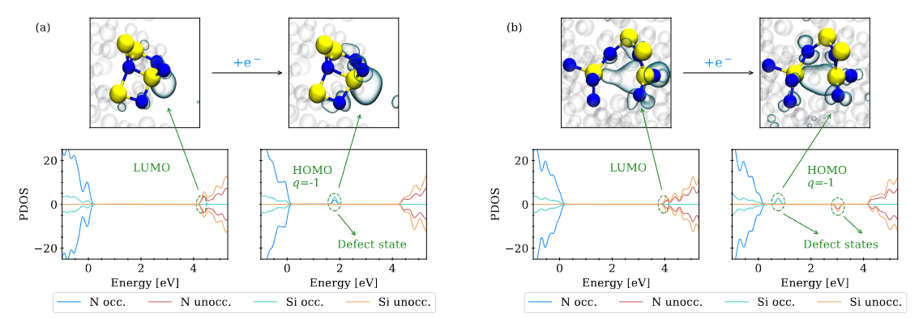

Localization of Trapped Electron
Wilhelmer, Christoph, et al. Nanomaterials 13.16 (2023): 2286.
Trapped electron is localized within the trap nitride device structure.
~0.1Å
$$l_{e}$$
: Trapped electron modeled as Aperiodic cubit trap site
(cf. cubit in size of atom, finite potential well)

Slide 8
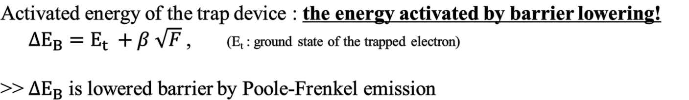
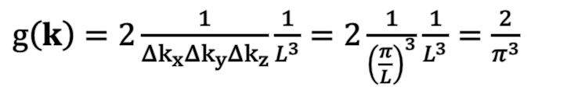
Trap to Band Tunneling
${dJ}_{1→2}=q TC\left(ε_{x}\right)v_{x}{dn}_{x}=qTC\left(ε_{x}\right)v_{x}g_{x}\left(k_{x}\right)f_{1}\left(ε\right)\left(1−f_{2}\left(ε\right)\right){dk}_{x}$
$g\left(k\right)=2\frac{1}{Δk_{x}Δk_{y}Δk_{z}}\frac{1}{L^{3}}=2\frac{1}{{\left(\frac{π}{L}\right)}^{3}}\frac{1}{L^{3}}=\frac{2}{π^{3}}$
Assumption:
Trap = Aperiodic potential well
DoS of aperiodic cubit
$J=q\frac{4m}{{π^{2}ℏ}^{3}} ∫TC\left(ε_{x}\right)N\left(ε_{x}\right) dε_{x}$ : Trap-to-Band Tunneling Current Model
Activated energy of the trap device : the energy activated by barrier lowering!
${ΔE}_{B}=E_{t} +β \sqrt{F}$ , (E_{t} : ground state of the trapped electron)
>> ${ΔE}_{B}$ is lowered barrier by Poole-Frenkel emission

Slide 9






Trap to Band Tunneling
$J=q\frac{4m}{{π^{2}ℏ}^{3}} ∫TC\left(ε_{x}\right)N\left(ε_{x}\right) dε_{x}$ : Trap-to-Band Tunneling Current Model
$N\left(ε_{x}\right)=∫f_{1}\left(ε\right) \left(1−f_{2}\left(ε\right)\right) dε_{ρ} ≈∫f_{1}\left(ε\right) dε_{ρ}=\left\{\begin{aligned}{Δε}_{B} −ε_{x} \left(0<ε_{x}<{Δε}_{B}\right) \\ 0 \left(ε_{x}>{Δε}_{B}\right)\end{aligned}\right.$
${Δε}_{B}$ : Lowered Barrier (by Poole-Frenkel)
~0.1Å
$$l_{e}$$
(maximum state of trapped electron)
TC
$${Δε}_{B}$$
Effective Area : $l_{e}^{2}={\left(λ_{e}b\right)}^{2}$
$ε_{t}$
Trap to Band Tunneling
(ground state of trapped electron)
$λ_{e}$ : electron matter wavelength
b : volume correction parameter
$e_{TBT}= ν_{TBT}×TC=\frac{J}{q}×\left(l_{e}^{2}\right)×\left(\# of traps\right)×\int_{0}^{{Δε}_{B}}{TC\left(ε_{x}\right)\left({Δε}_{B}−ε_{x}\right) dε_{x}}$

Slide 10
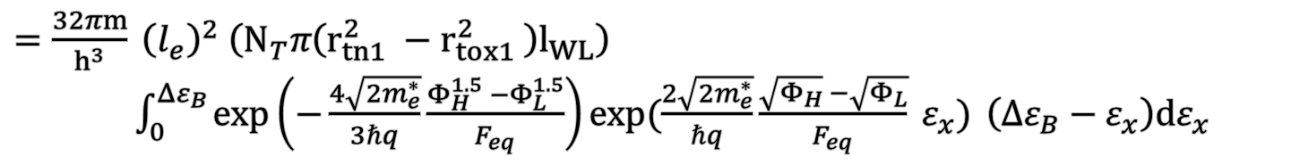
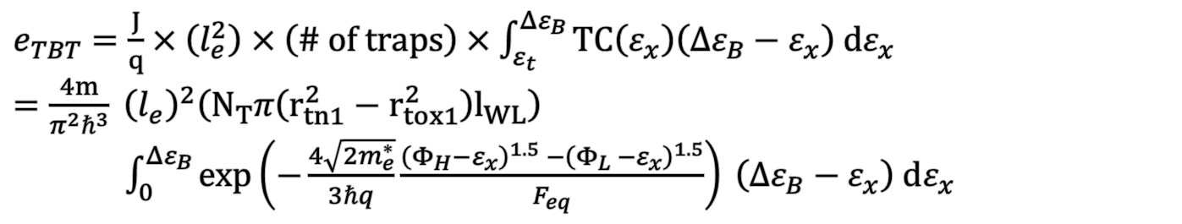

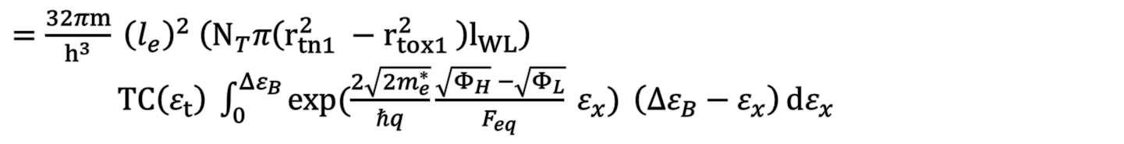
Trap to Band Tunneling
$e_{TBT}=\frac{J}{q}×\left(l_{e}^{2}\right)×\left(\# of traps\right)×\int_{ε_{t}}^{{Δε}_{B}}{TC\left(ε_{x}\right)\left({Δε}_{B}−ε_{x}\right) dε_{x}}$
$=\frac{4m}{π^{2}ℏ^{3}} {\left(l_{e}\right)}^{2}\left(N_{T}π\left(r_{tn1}^{2}−r_{tox1}^{2}\right)l_{WL}\right)$
$\int_{0}^{{Δε}_{B}}{\exp\left(−\frac{4\sqrt{2m_{e}^{∗}}}{3ℏq}\frac{{\left(Φ_{H}−ε_{x}\right)}^{1.5} −{\left(Φ_{L} −ε_{x}\right)}^{1.5}}{F_{eq}}\right) \left({Δε}_{B}−ε_{x}\right) dε_{x} }$
$=\frac{32πm}{h^{3}} {\left(l_{e}\right)}^{2} \left(N_{T}π\left(r_{tn1}^{2} −r_{tox1}^{2} \right)l_{WL}\right)$
$\int_{0}^{{Δε}_{B}}{\exp\left(−\frac{4\sqrt{2m_{e}^{∗}}}{3ℏq}\frac{Φ_{H}^{1.5} −Φ_{L}^{1.5}}{F_{eq}}\right)\exp{(\frac{2\sqrt{2m_{e}^{∗}}}{ℏq}\frac{\sqrt{Φ_{H}} −\sqrt{Φ_{L}}}{F_{eq}} ε_{x})} \left({Δε}_{B}−ε_{x}\right)dε_{x}}$
$$TC\left(ε_{t}\right)$$
$=\frac{32πm}{h^{3}} {\left(l_{e}\right)}^{2} \left(N_{T}π\left(r_{tn1}^{2} −r_{tox1}^{2} \right)l_{WL}\right)$
$TC\left(ε_{t}\right) \int_{0}^{{Δε}_{B}}{\exp{(\frac{2\sqrt{2m_{e}^{∗}}}{ℏq}\frac{\sqrt{Φ_{H}} −\sqrt{Φ_{L}}}{F_{eq}} ε_{x})} \left({Δε}_{B}−ε_{x}\right){dε_{x}}}$

Slide 11
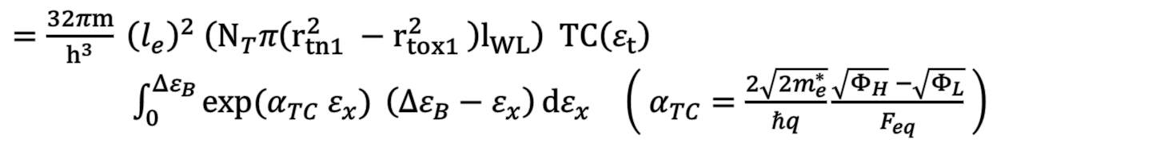

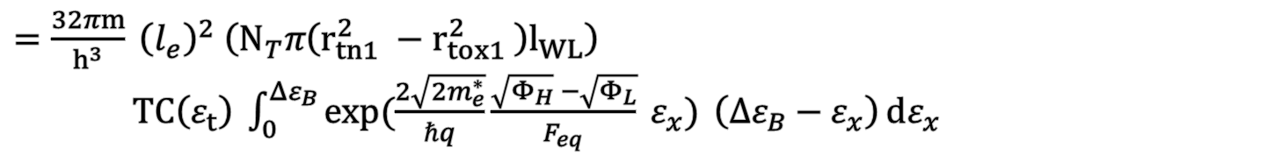

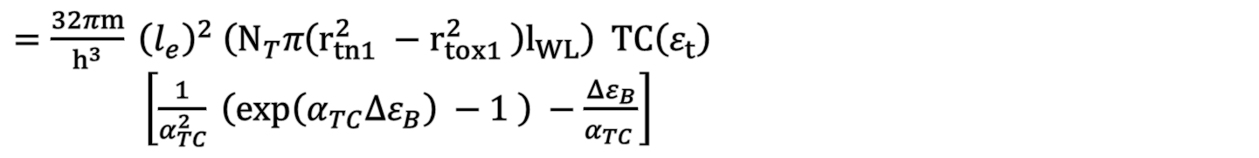
Trap to Band Tunneling
$=\frac{32πm}{h^{3}} {\left(l_{e}\right)}^{2} \left(N_{T}π\left(r_{tn1}^{2} −r_{tox1}^{2} \right)l_{WL}\right)$
$TC\left(ε_{t}\right) \int_{0}^{{Δε}_{B}}{\exp{(\frac{2\sqrt{2m_{e}^{∗}}}{ℏq}\frac{\sqrt{Φ_{H}} −\sqrt{Φ_{L}}}{F_{eq}} ε_{x})} \left({Δε}_{B}−ε_{x}\right){dε_{x}}}$
$=\frac{32πm}{h^{3}} {\left(l_{e}\right)}^{2} \left(N_{T}π\left(r_{tn1}^{2} −r_{tox1}^{2} \right)l_{WL}\right) TC\left(ε_{t}\right)$ $\int_{0}^{{Δε}_{B}}{\exp{(α_{TC} ε_{x})} \left({Δε}_{B}−ε_{x}\right){dε_{x}}}$ $\left( α_{TC}=\frac{2\sqrt{2m_{e}^{∗}}}{ℏq}\frac{\sqrt{Φ_{H}} −\sqrt{Φ_{L}}}{F_{eq}} \right)$
$=\frac{32πm}{h^{3}} {\left(l_{e}\right)}^{2} \left(N_{T}π\left(r_{tn1}^{2} −r_{tox1}^{2} \right)l_{WL}\right) TC\left(ε_{t}\right)$
$\left[\frac{1}{α_{TC}^{2}} \left(\exp\left(α_{TC}{Δε}_{B}\right) −1 \right) −\frac{{Δε}_{B}}{α_{TC} }\right]$
$e_{TBT}=\frac{32πm}{h^{3}} {\left(l_{e}\right)}^{2}\left(N_{T}π\left(r_{tn1}^{2}−r_{tox1}^{2} \right)l_{WL}\right)\left[\frac{1}{α_{TC}^{2}} \left(\exp\left(α_{TC}{Δε}_{B}\right)−1 \right)−\frac{{Δε}_{B}}{α_{TC}}\right]TC\left(ε_{t}\right)$
$${⇒ν}_{TBT}$$
$=ν_{TBT}×TC \left(ε_{t}\right)$

Slide 12
Trap to Band Tunneling
Idea of the modeling
Conventional TBT
Proposed TBT
TC
TC
TC
TC
TC
Tunneling current
Trap 된 전자들은 모두 동일한 tunneling current
각각의 전자들이 별개로 움직임

Slide 13

Final Result
Direct Tunneling
$e_{DT}=\frac{4πm}{h^{3}} 2πr_{tox1}l_{WL}\frac{{\left(kT\right)}^{2}}{1−α_{TC}×kT}\frac{n_{C}}{N_{C}}TC\left(E_{c}\right)$
Trap to Band Tunneling
$e_{TBT}=\frac{32πm}{h^{3}} {\left(l_{e}\right)}^{2}\left(N_{T}π\left(r_{tn1}^{2}−r_{tox1}^{2} \right)l_{WL}\right)\left[\frac{1}{α_{TC}^{2}} \left(\exp\left(α_{TC}Δε_{Fn}\right)−1 \right)−\frac{Δε_{Fn}}{α_{TC}^{2}}\right]TC\left(ε_{t}\right)$

